Slide 1
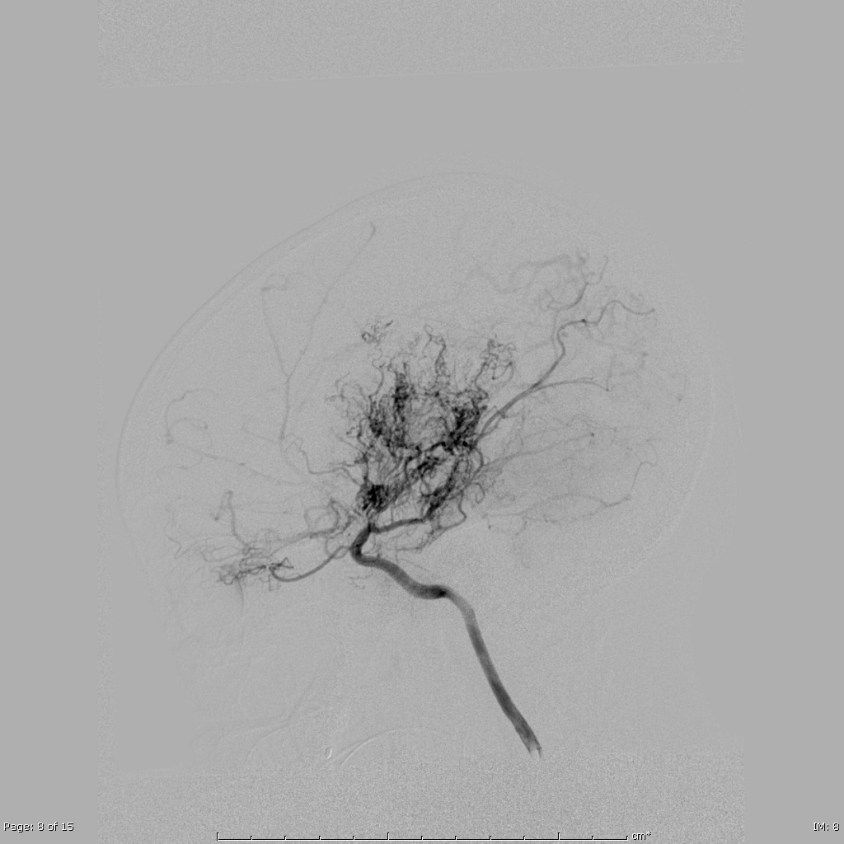
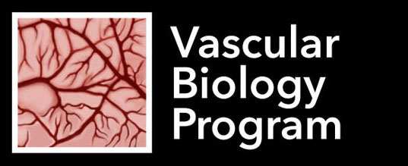
Advances in Research for Moyamoya
Edward R. Smith

Slide 2
Transdural collaterals are present in nearly half of all moyamoya patients.
Transdural collaterals
  are more common in advanced disease
  are associated with stroke as a perioperative complication
  may suggest increased capacity to produce surgical collaterals postoperatively
These data support the utility of preoperative arteriograms and this work has reduced intraoperative stroke by >40%.
Notes:
Should we add: only double operations on XRT kids, clinical MRS improved in everyone, only grade C matsushimas are from XRT

Slide 3
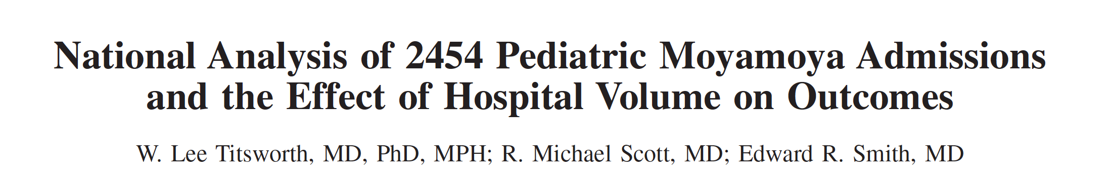
What have we done?
Metric | Low Volume | High Volume
LOS | 6.2 d | 4.7 d (32%)
Charges | $138,000 | $88,000 (57%)
Nonroutine discharge | 8.2 fold higher | *
Death (any care) | 15.7 fold higher | *
Stroke 2016;47:1303-1311.

Slide 4

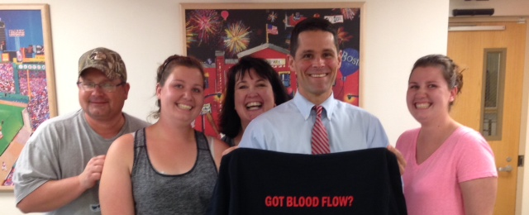
We Need Teamwork To Do This

